Slide 1
Physiology of Taste
Dr Deepa G S
Associate Professor
SKHMC
Kulasekaram

Slide 2
Taste buds
Receptor organs for taste sensation or gustation
No-10,000
Measurement-50-70micrometer

Slide 3
Situation
Fungiform papillae- Ant 2/3 of tongue,5 taste buds/ papillae
Filiform papillae- diverging rows to right and left of midline, No taste buds
Circumvallate papillae- in the form of inverted V on the back of tongue-100taste bud/papillae
Foliate- posterolateral surface of tongue
Pharyngeal and laryngeal taste buds-vagus
Palatal taste buds-Facial N

Slide 4
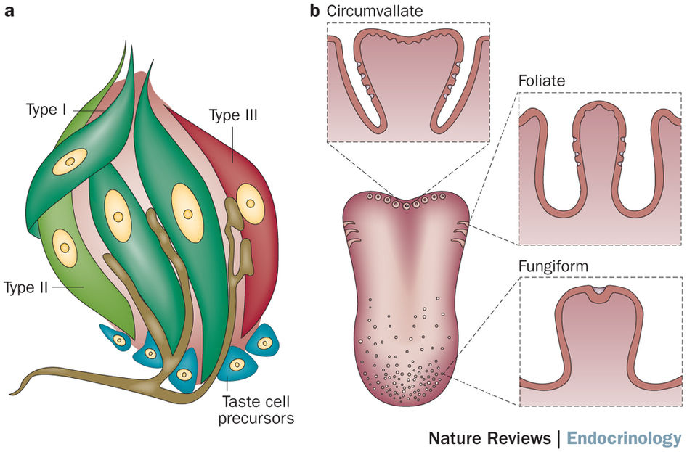

Slide 5
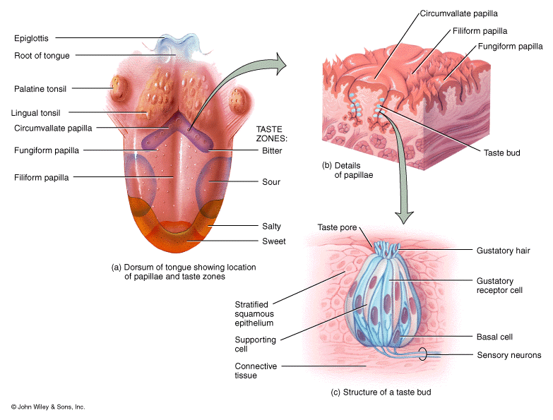

Slide 6
Taste buds-Structure
Oval shaped multicellular structures
Types of cells present in taste buds
Basal cells
Supporting cells or sustentacular cells
Gustatory receptor cells

Slide 7
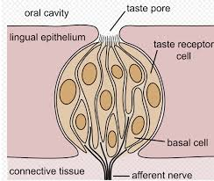
Taste bud
https://en.wikipedia.org/wiki/Taste

Slide 8
Taste buds-Structure
Gustatory receptor cells
A taste bud contains 50-150 receptor cells
Extends full length of taste bud
The receptor cells have microvilli, which project into an opening in epithelium covering the tongue. This opening is called taste pore.
The apical regions of receptor and supporting cells are joined by tight junctions
Life span-10 days
Each taste bud is innervated by 50 afferent fibers each afferent fiber receives input form 5 taste buds

Slide 9
PATHWAY FOR TASTE
RECEPTORS : type III cells
FIRST ORDER NEURON
First order neurons of taste pathway are in the nuclei
of three different cranial nerves, situated in medulla
oblongata.
1.Chorda tympani fibers of facial nerve, which run from anterior two third of tongue
2. Glossopharyngeal nerve fibers, which run from posterior one third of the tongue
3. Vagal fibers, which run from taste buds in otherregions.
Terminate in the nucleus of tractus solitarius.

Slide 10
PATHWAY FOR TASTE
Second order neuron:Nucleus of tractus solitarius
Axons of second order neurons run through medial
lemniscus and terminate in posteroventral nucleus
of thalamus.
Third order neuron: Posteroventral nucleus of thalamus.
Axons from third order neurons project into parietal
lobe of the cerebral cortex.

Slide 11
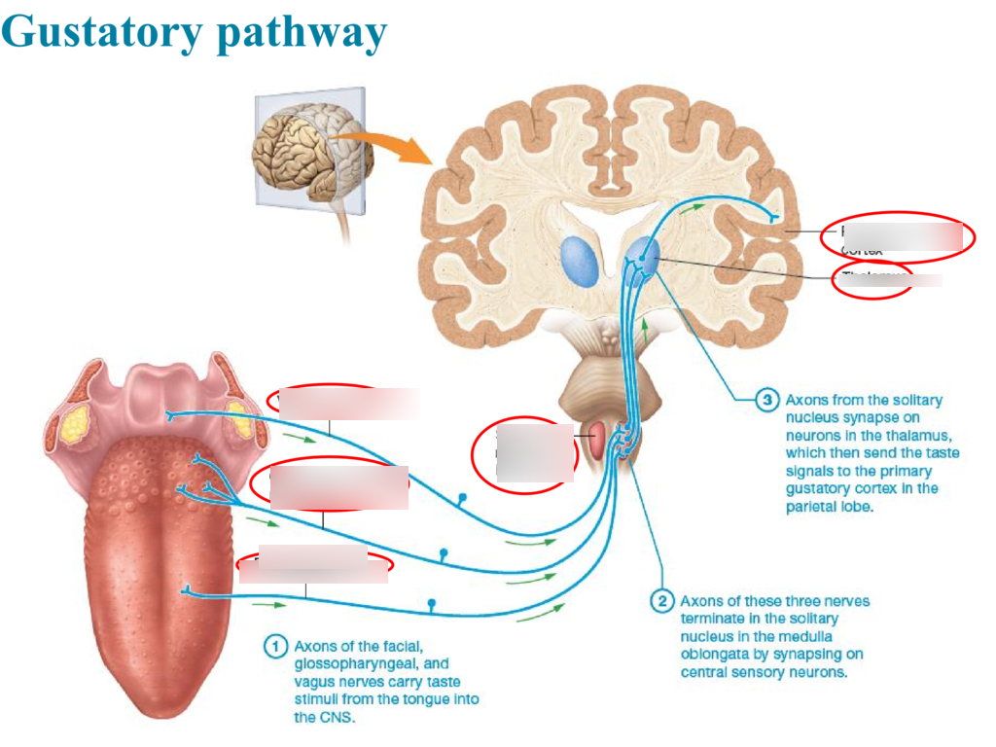
https://quizlet.com/415750124/gustatory-pathway-diagram/

Slide 12
PATHWAY FOR TASTE
TASTE CENTER
Center for taste sensation is in opercular insular cortex, i.e. in the lower part of postcentral gyrus, which receives cutaneous sensations from face.
Thus, the taste fibers do not have an independent cortical projection.

Slide 13
Mechanism of taste perception
Taste producing substance dissolves in oral fluid and acts by forming weak attachment to receptors on microvilli of gustatory cells
This combination evokes generator potential in receptor cell and action potential generated in sensory nerves

Slide 14
PRIMARY TASTE SENSATIONS
Primary or fundamental taste sensations are divided
into five types:
1. Sweet
2. Salt
3. Sour
4. Bitter
5. Umami.
Man can perceive more than 100 different tastes.
Other taste sensations are just the combination of two
or more primary taste sensations

Slide 15
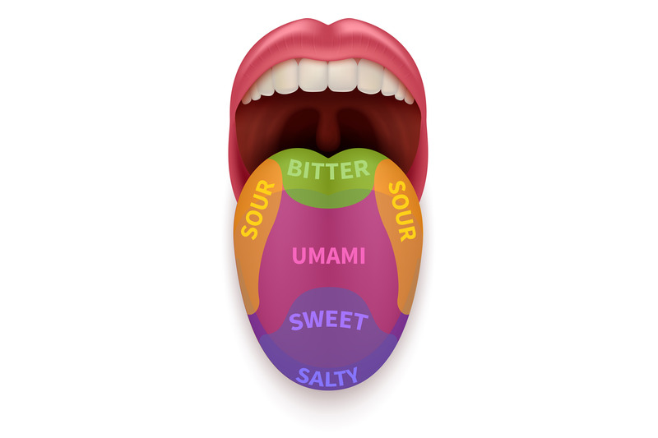
Taste areas
https://thehungryjpeg.com/product/3621001-realistic-tongue-with-basic-taste-areas-tasting-map-in-human-mouth-sw

Slide 16
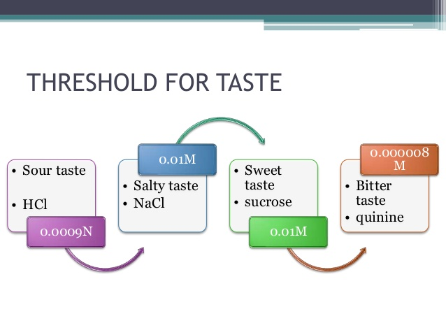
https://www.slideshare.net/tinugeorge319/taste-pathway

Slide 17
Factors affecting taste sensation
Area of stimulation-Threshold decreases when area of stimulation increases
Duration-If duration is more response is quick
Temperature-maximum sensitivity T 30-40° C.
Olfaction-flavours of foods are combinations of taste and smell
Individual variation-reduction in old age
Sex-Womne more sensitive to sweet and salt and less sensitive to sour than man

Slide 18
Factors affecting taste sensation
Adaptation-Taste buds quickly adapts to a particular taste if we apply continuously a substance on tongue
Taste preference-prefer food based on the need of body
Eg: adrenelectamized persons prefer salt water to pure water
Affective nature of food- Pleasentness and unpleasantness are the affective nature of food which makes an individual reject or accept a food

Slide 19
Applied
Aguesia-loss of taste
Hypoguesia is the decrease in taste sensation
Dysguesia-altered Taste sensation.

Slide 20
Physiology of Smell(Olfaction)

Slide 21
Olfactory receptors
Situation-yellowish brown olfactory mucus membrane in
the roof of nasal cavity
500 m square
cells
10-20 million receptor cells-(6-12 cilia)
sustentacular cells (lecithin,phospholipids,auto oxidation products)
Mucus secreting bowman’s glands

Slide 22
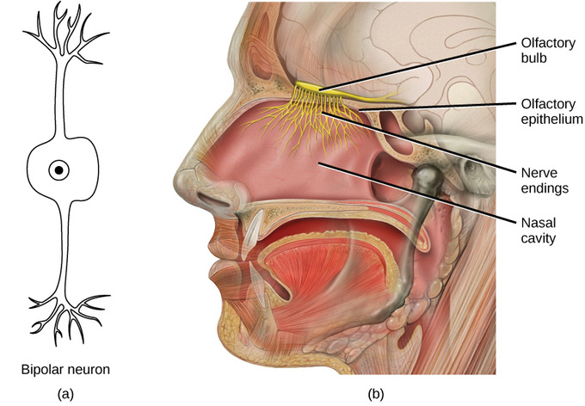
Olfactory receptors
https://courses.lumenlearning.com/boundless-ap/chapter/taste-and-olfaction/

Slide 23
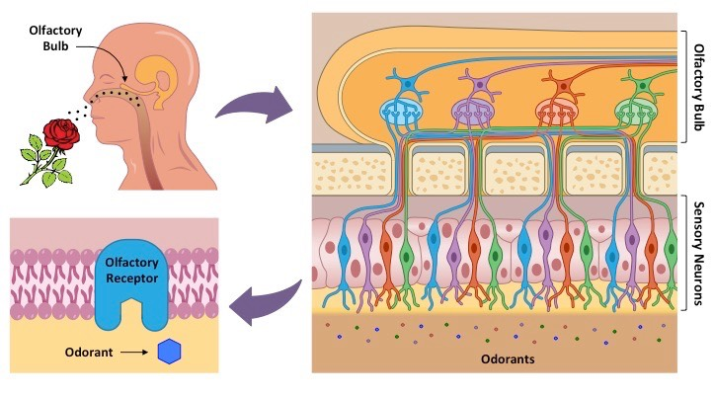
https://ib.bioninja.com.au/options/option-a-neurobiology-and/a3-perception-of-stimuli/olfaction.html

Slide 24
Olfactory Pathway
Axons of bipolar olfactory receptors pierce the cribriform plate of ethmoid bone and reach the olfactory bulb
Axons synapse with dendrites of mitral cells and tufted cells
Different groups of these synapses form globular structures called olfactory glomeruli.
Axons of mitral cells and tufted cells leave the olfactory bulb and form olfactory tract.

Slide 25
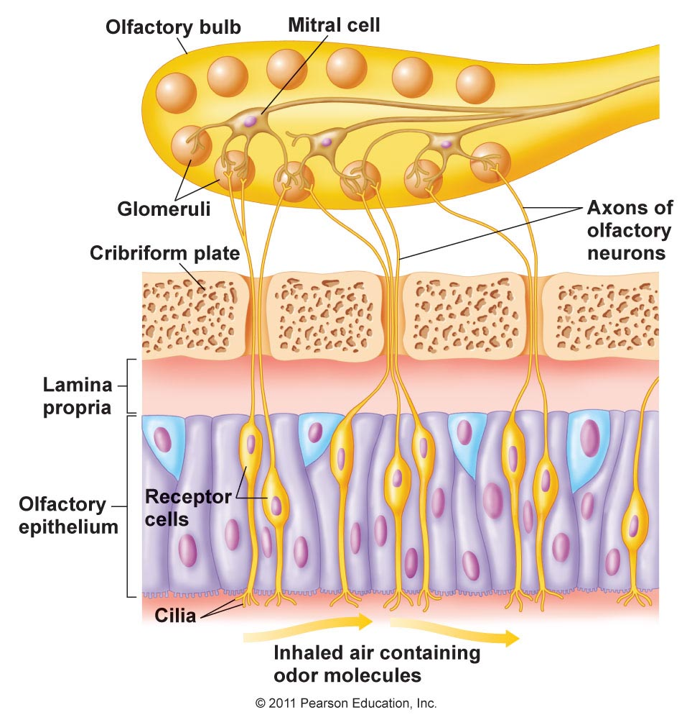

Slide 26
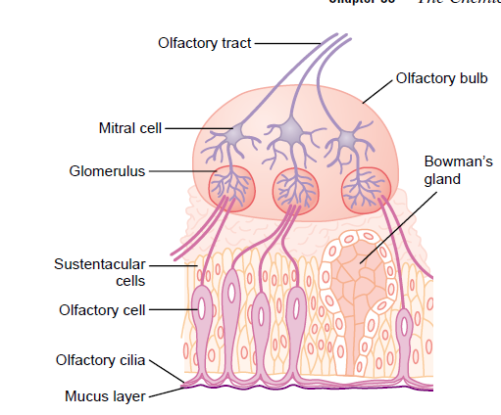
Picture Courtesy:Guyton and Hall’s Text book of Medical Physiology

Slide 27
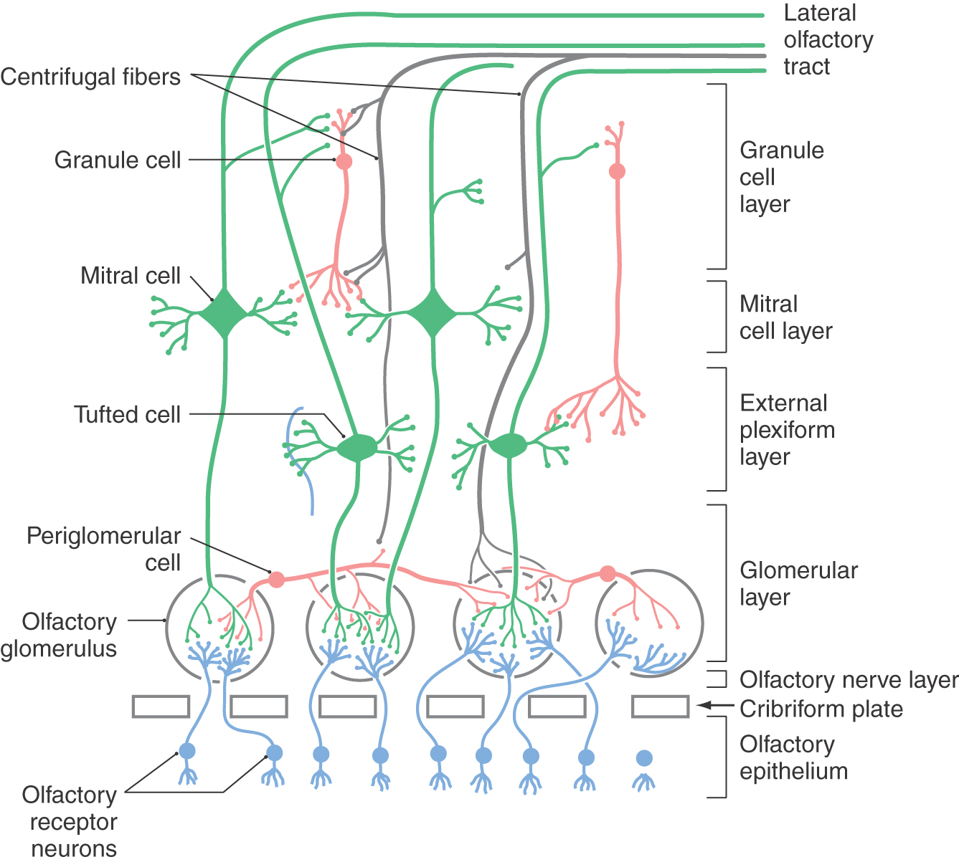
Olfactory Pathway

Slide 28
Olfactory Pathway
Axons of mitral cells form Lateral striae- Olfactory cortex which
includes
Ant. Olfactory nucleus- cordination of input from contralateral olfactory cortex
Pyriform cortex-discrimination and perception
Amygdala-emotional response
Entorhinal cortex-olfactory memories
Intermediate striae-Olfactory tubercle and hence limbic
system
Axons of tufted cells form Medial olfactory striae-Granule
cells in opposite olfactorybulb

Slide 29
Each Glomerulus receives impulses from 2600 receptors and passes to 24 mitral cells and 68 tufted cells
Applied Aspects
Anosmia
Complete absence of smell
Parosmia
Alteration in charecter of smell
Hyposmia
Reduction in sense of smell

Slide 30
Reference:
Text Book of Physiology,A.K.JainFourth edition
Essentials of medical Physiology: K.sembulinhgam Prema sembulingam,Eigth edition
Text book of Medical Physiology,Geetha N,2nd edition.

Slide 31
THANK YOU

